Slide 1
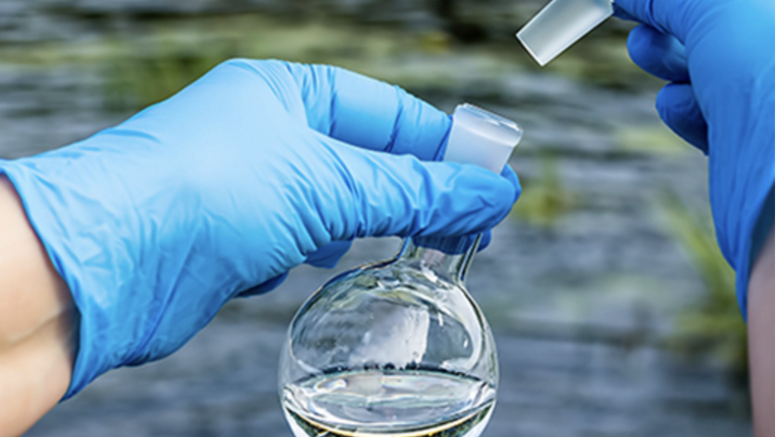
ENVIRONMENTAL SUSTAINABILITY
Machine Learning: Predicting the Potability of Water
By: Jessica Zimmerman | Beruchya Dao-Bai | Mohamad Kassim | Elizaveta Lyadova
https://github.com/jessezimm/Environmental_Sustainability

Slide 2
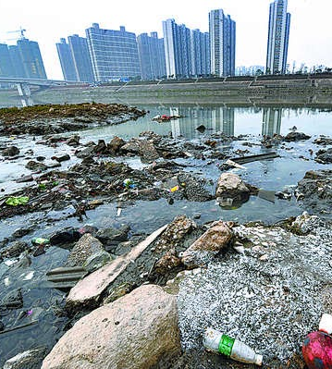
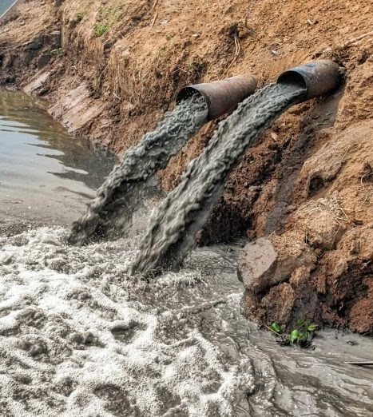
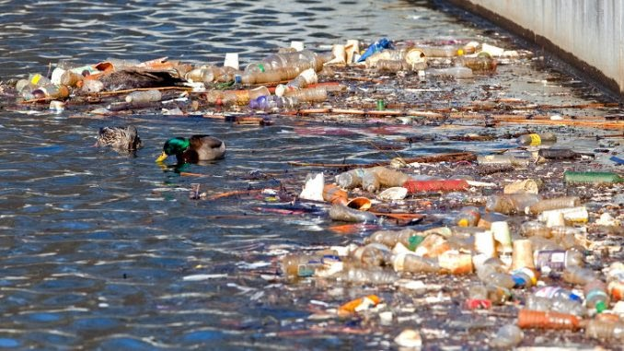
SELECTED TOPIC & REASONING
Environmental sustainability is one of the most pressing issues of the century. From climate change to pollution, major ills to the environment affect humanity and the biosphere. Given the urgency of action on environmental sustainability, our group saw it fit to inform the world on water pollution and the suitability of drinking water.

Slide 3
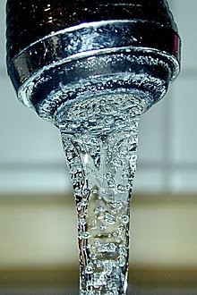


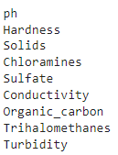

QUESTIONS TO ANSWER THROUGH MODEL
What makes water potable?
Important variables
What factors contribute to water potability?

Slide 4
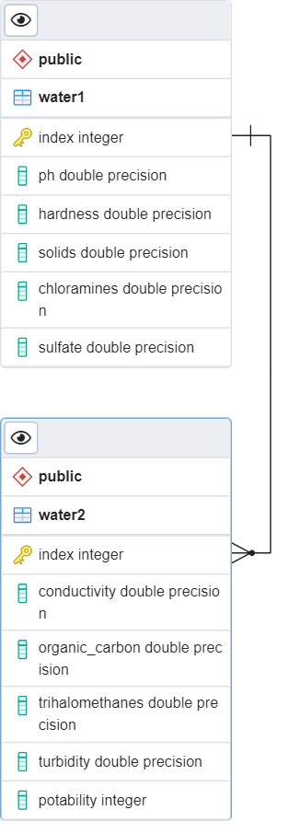



DATA SOURCE & DATABASE
Data source: https://www.waterqualitydata.us/
The final dataset contains water characteristics from 3276 different water samples
SQL database created and hosted in cloud through Microsoft Azure
IP addresses were used to manage security and connect to the server
Two datasets joined together using a common index
An engine in Jupyter notebook accesses the database

Slide 5
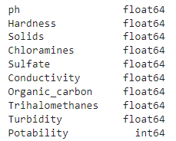

DATA PREPROCESSING
Confirm all data is numeric or convert if needed
Fill null values with mean of column

Slide 6
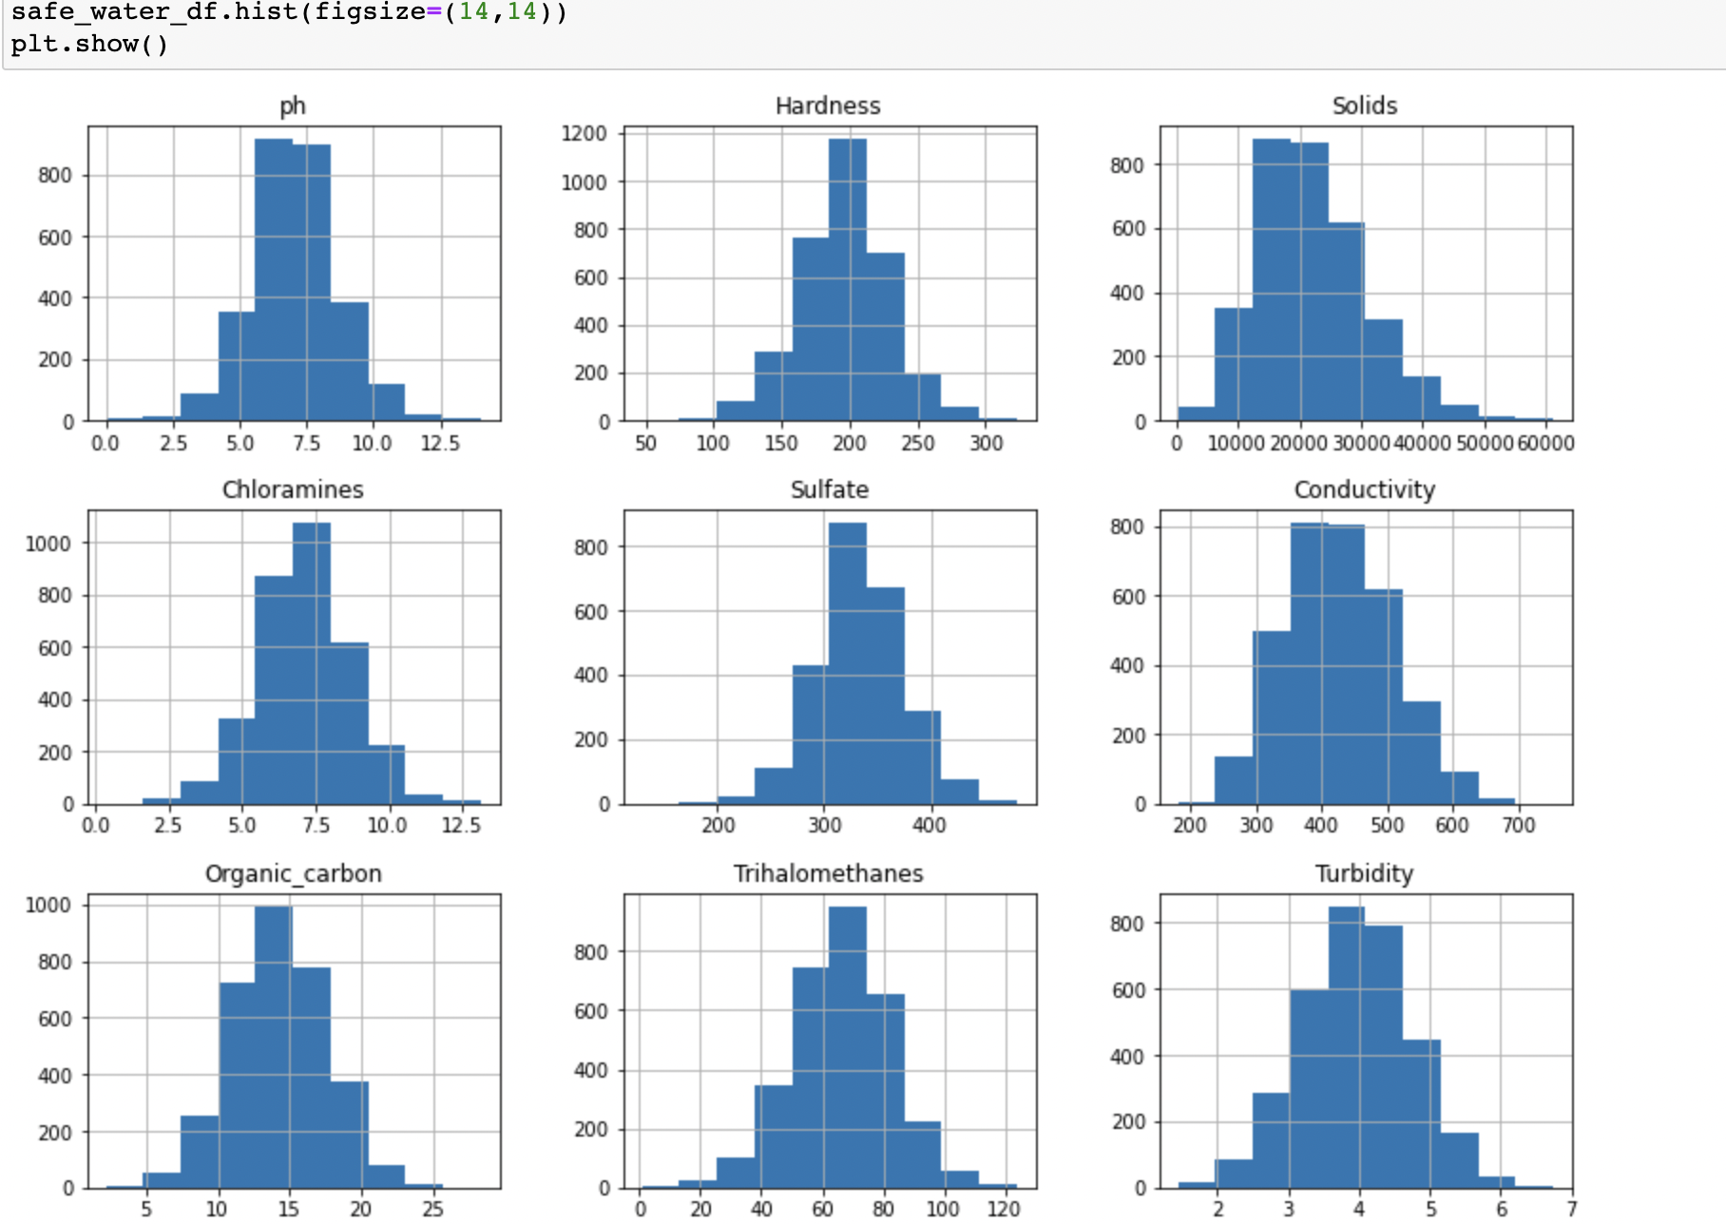
Visualize all the features of the data set

Slide 7
Exploratory Data Analysis
Feature Selection: imblearn package to assess feature importance
Result: No stand-out variables. Keep all variables.
Feature Transformation: sklearn package for scaling variables
Result: Limits influence of large data values. Aim for better model accuracy.
Notes:
each feature scaled to mean of 0 and std dev of 1; helps with datasets sensitive to large values <- ours because limited data

Slide 8
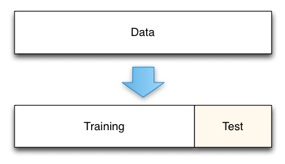
Train & Test Splits
Sklearn package for splitting data
Changed train size to 80%
Increased random state to 78
Notes:
each feature scaled to mean of 0 and std dev of 1; helps with datasets sensitive to large values <- ours because limited data
Stratify - that is in the original dataset, in the test/train datasets as well
Stratified on “y” to preserve the proportion of target (potability)

Slide 9
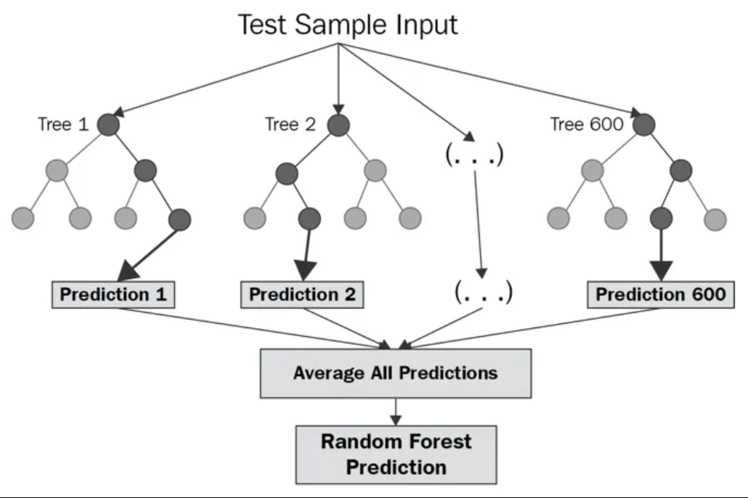
Machine Learning Model
Model Type: Balanced Random Forest Classifier
Creates smaller simpler decision trees based on a random subset of features
Smaller trees combine to create a strong learner

Slide 10
Model Benefits & Limitations
Benefits
Robust against overfitting
Smaller decision trees are trained on different subsets
N_estimators input enables easy algorithm tuning
Higher number of trees usually yields better performance
Limitations
Feature importance outputs show minimal variability
Model is not easily interpretable
Computationally intensive with large datasets
Notes:
This model is robust against overfitting because the smaller decision trees are trained on different pieces of data. However, all features are displaying similar importance in the model and thus it is difficult to eliminate features.
Algorithm tuning - (can increase) n_estimators : This is the number of trees you want to build before taking the maximum voting or averages of predictions. Higher number of trees give you better performance but makes your code slower.
Not easily interpretable - especially when increasing the number of trees
Computational intensive -

Slide 11
Results
Accuracy Score
Confusion Matrix

Slide 12
Dashboard Demo
Using Tableau, we …

Slide 13
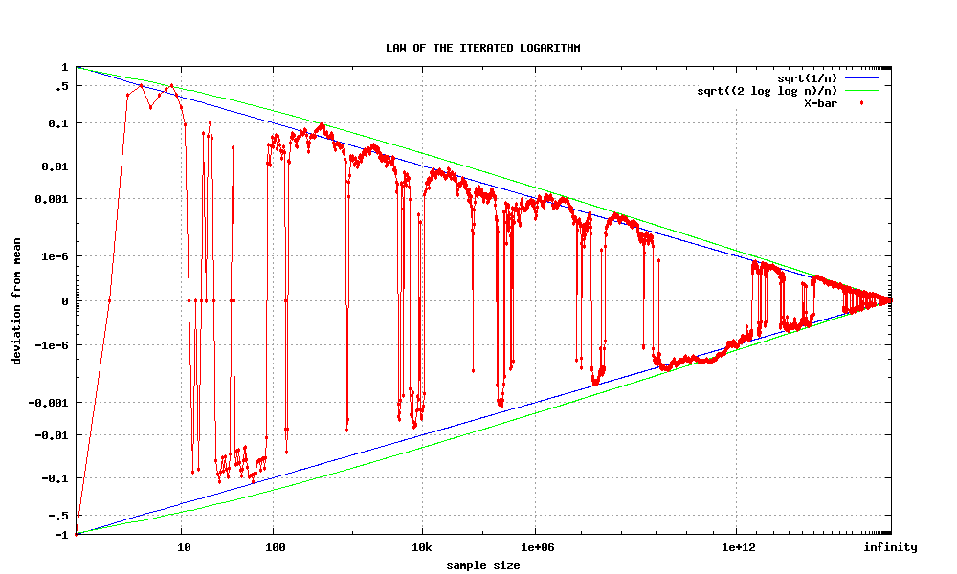
Key Takeaways
Potability is not well predicted by our model
Attempts at model improvement were dismal
Treated missing values,
Feature selection
Feature transformation
Algorithm tuning
A larger dataset likely yields more conclusive results

Slide 14
Technologies, languages, tools, and algorithms used throughout the project:
GitHub, Python, Pandas, SQL, Tableau, ….

Slide 15


